Slide 1

News-To-Market
Group 2
ISSS610:
Applied Machine Learning
Asmit Adgaonkar Brijesh Gupta
Clarence Tan Yan Zhi
Debasish Behera
Eric Prabowo Cundomanik
Franky Eddy

Slide 2

Project Scope

Slide 3
Project Scope
Motivation
Apply machine learning techniques to make a data oriented decision
Make use of external data to help predict the market data and its movements
Combine the concepts of machine learning and text analytics to gain better insights both from market data and text data (i.e. News and Forums)
Data
RedditNews.csv: Historical news headlines from Reddit World News Channel.
DJIA_tables.csv: Daily rates of Dow Jones Industrial Average (DJIA) from date range 08/08/2008 to 01/07/2016.
Combined_News_DJIA.csv: Combined dataset of both Reddit News and DJIA tables dataset. Label reflects the binary classification as below:
"1" when DJIA Adjusted Close value rose or stayed the same
"0" when DJIA Adjusted Close value decreased.

Slide 4
Objectives
Predict DJIA end of day market direction using World News
Understand the influence of text/news data as a possible way of understanding market movement and warrant for further research accordingly.

Slide 5

Approaches

Slide 6
Methodology
Exploratory Analysis
Data Preparation
Data Representation
Semantic Analysis
Model Fitting
Sentiment Analysis
Model Comparison

Slide 7
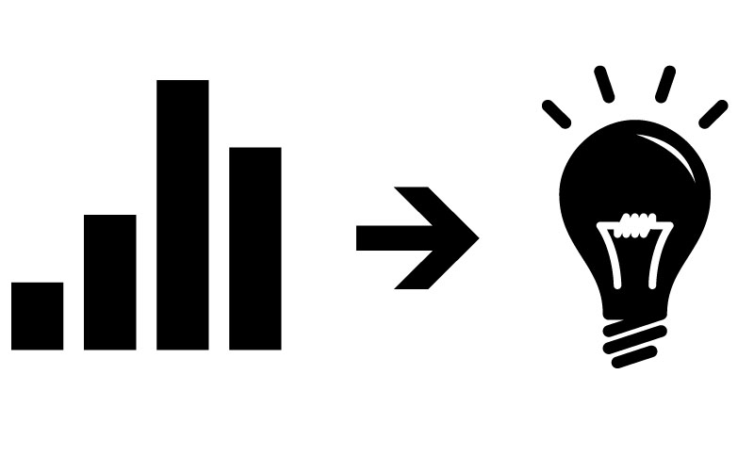

Data Preparation

Slide 8
Data Preparation
Corpus Generation
Stop Word Removal
Word Stemming
Data Representation
BOW, tfidf, ngram = 1
BOW, tfidf, ngram = 2
BOW, POS, tfidf, ngram = 1
BOW, POS, tfidf, ngram = 2
BOW, tfidf, ngram = 1,2, Weighted Sentiments

Slide 9
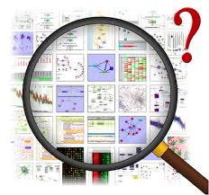
Exploratory Analysis

Slide 10
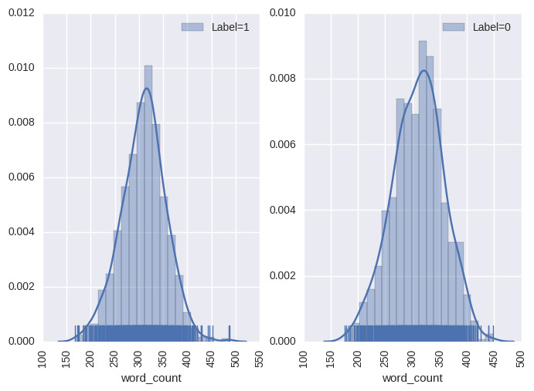
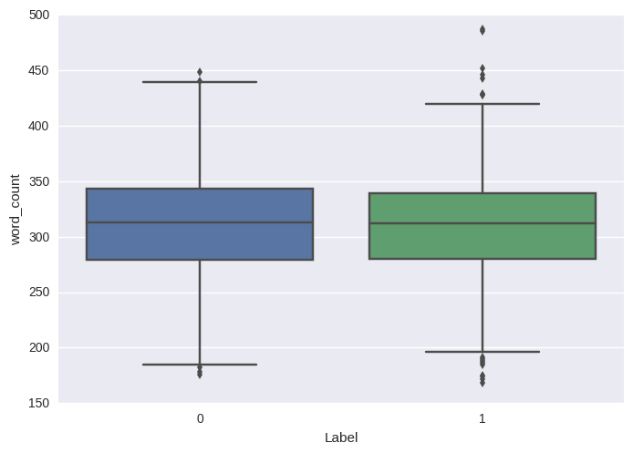
Word Count
Word Count Histogram
Word Count Box Plot
Average word count is centered around 300
Label = 1 seems slightly right skewed
Distribution of word count is close to normal distribution
More variation of the word counts can be seen for label = 1

Slide 11
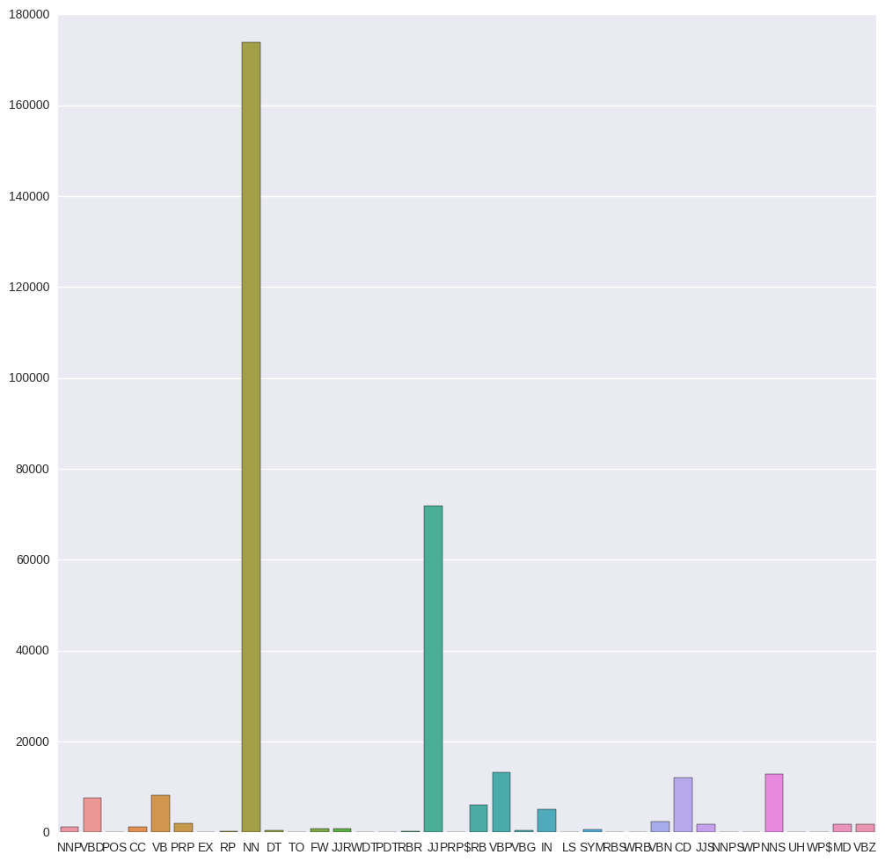
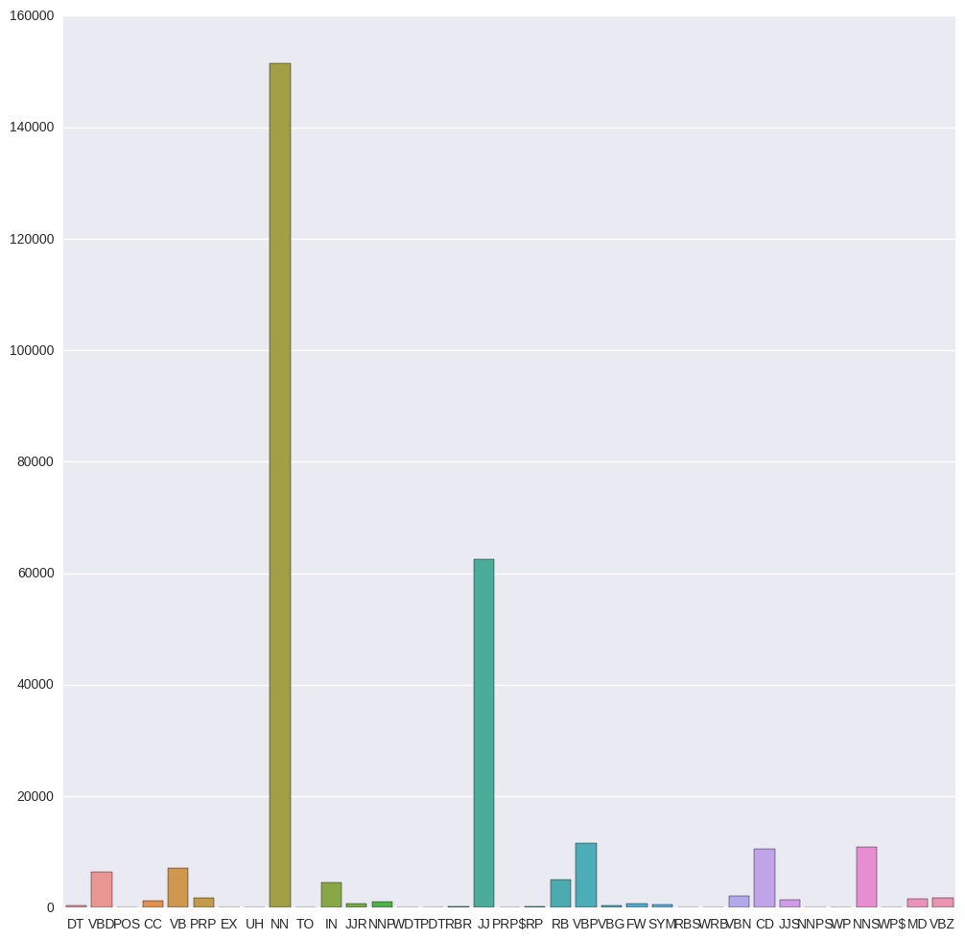
Distribution of POS Tags
Market Up
Market Down
Similar distribution of POS tags for both labels
Noun and adjective are the most dominant POS tags

Slide 12
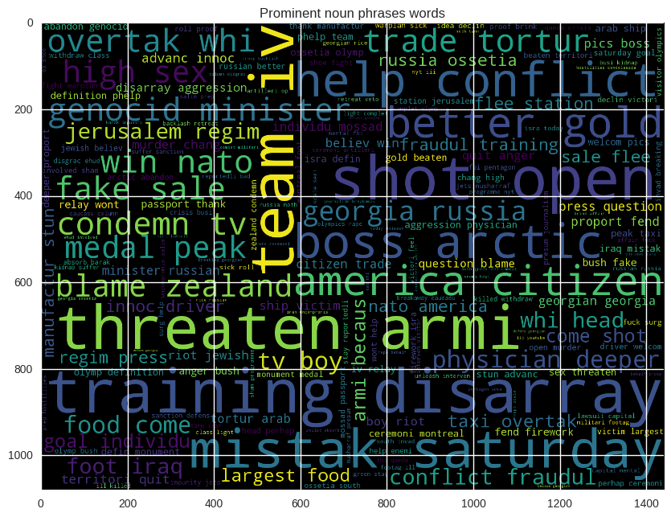
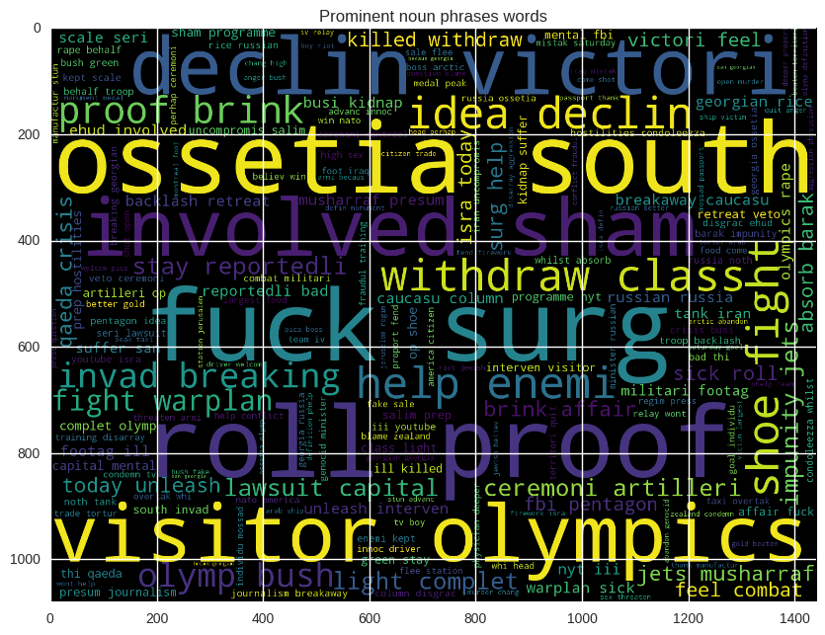
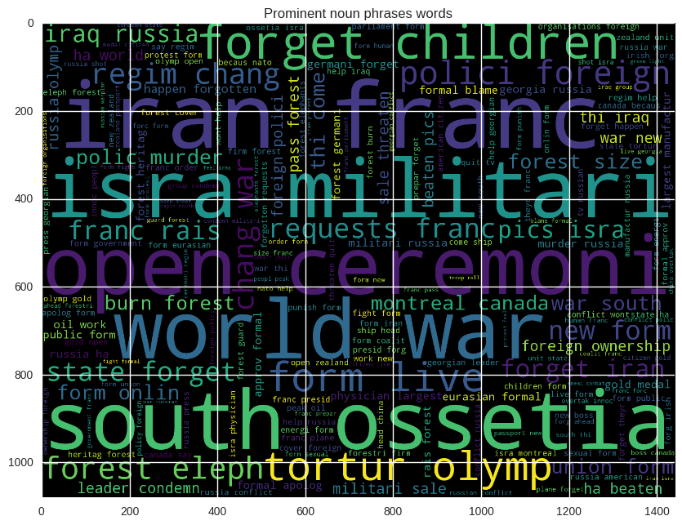
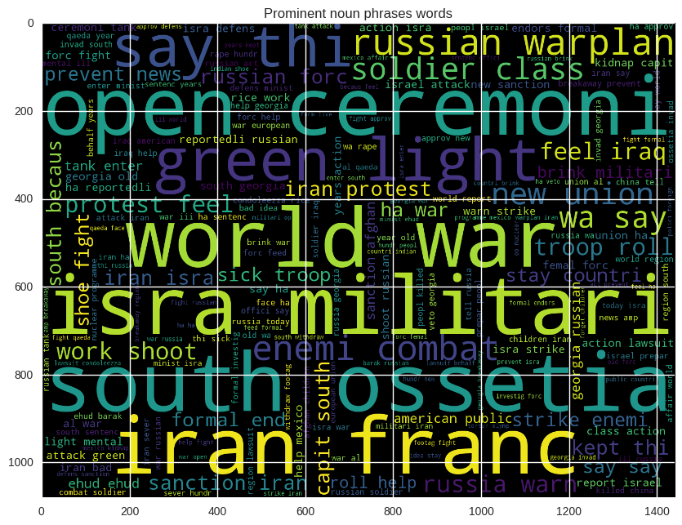
Word Cloud
Tf-idf ; n-gram: 1 ; Label = 1
Tf-idf; n-gram:1 ; Label = 0
Tf-idf; n-gram: 2 ; Label = 1
Tf-idf; n-gram: 2 ; Label = 0

Slide 13

Model Fitting

Slide 14
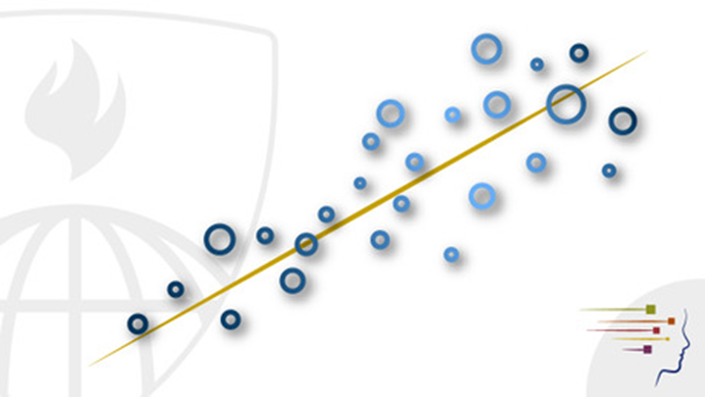
Models
Linear Model
KNeighborsClassifier
MultinomialNB
DecisionTreeClassifier
RandomForest
AdaBoostClassifier
BaggingClassifier
GaussianNB
SVC

Slide 15

Model Performance

Slide 16
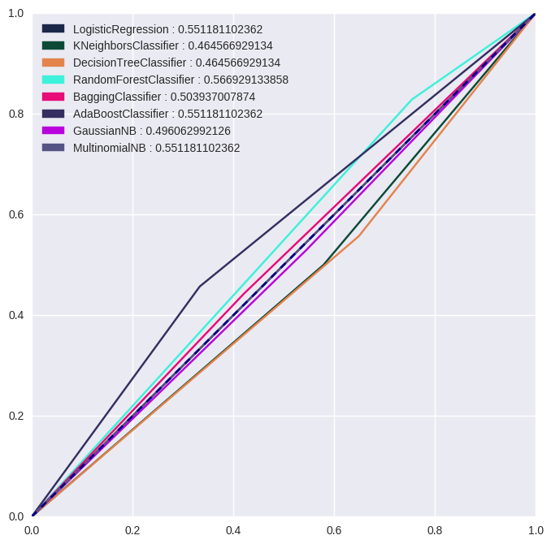
ngram = 1, with tf-idf representation
Model | Accuracy | F1 | Precision | Recall
Logistic Regression | 0.551181 | 0.710660 | 0.551181 | 1.000000
Kneighbors Classifier | 0.464567 | 0.507246 | 0.514706 | 0.500000
Decision Tree | 0.464567 | 0.534247 | 0.513158 | 0.557143
RandomForest | 0.566929 | 0.678363 | 0.574257 | 0.828571
Bagging | 0.503937 | 0.496000 | 0.563636 | 0.442857
AdaBoost | 0.551181 | 0.528926 | 0.627451 | 0.457143
GaussianNB | 0.496063 | 0.536232 | 0.544118 | 0.528571
MultinomialNB | 0.551181 | 0.710660 | 0.551181 | 1.000000
RandomForest has the highest accuracy (0.566929)

Slide 17
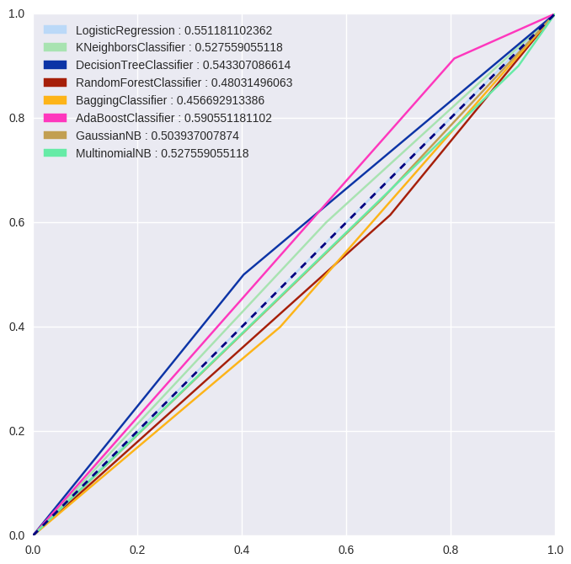
ngram = 2, with tf-idf representation
Model | Accuracy | F1 | Precision | Recall
LogisticRegression | 0.551181 | 0.710660 | 0.551181 | 1.000000
KNeighborsClassifier | 0.527559 | 0.583333 | 0.567568 | 0.600000
DecisionTree | 0.543307 | 0.546875 | 0.603448 | 0.500000
RandomForest | 0.480315 | 0.565789 | 0.524390 | 0.614286
BaggingClassifier | 0.456693 | 0.448000 | 0.509091 | 0.400000
AdaBoostClassifier | 0.590551 | 0.711111 | 0.581818 | 0.914286
GaussianNB | 0.503937 | 0.588235 | 0.542169 | 0.642857
MultinomialNB | 0.527559 | 0.677419 | 0.543103 | 0.900000
AdaBoost has the highest accuracy (0.590551)

Slide 18
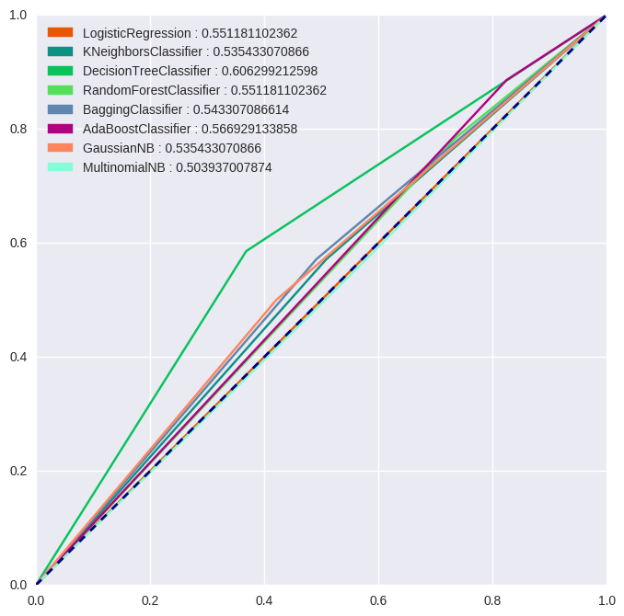
Model Performance (USING POS TAGS)
ngram = 1, with tf-idf representation
Model | Accuracy | F1 | Precision | Recall
Logistic Regression | 0.551181 | 0.710660 | 0.551181 | 1.000000
Kneighbors Classifier | 0.535433 | 0.575540 | 0.579710 | 0.571429
Decision Tree | 0.606299 | 0.621212 | 0.661290 | 0.585714
RandomForest | 0.551181 | 0.658683 | 0.567010 | 0.785714
Bagging | 0.543307 | 0.579710 | 0.588235 | 0.571429
AdaBoost | 0.566929 | 0.692737 | 0.568807 | 0.885714
GaussianNB | 0.535433 | 0.542636 | 0.593220 | 0.500000
MultinomialNB | 0.503937 | 0.559441 | 0.547945 | 0.571429
Decision Tree has the highest accuracy (0.606299)

Slide 19
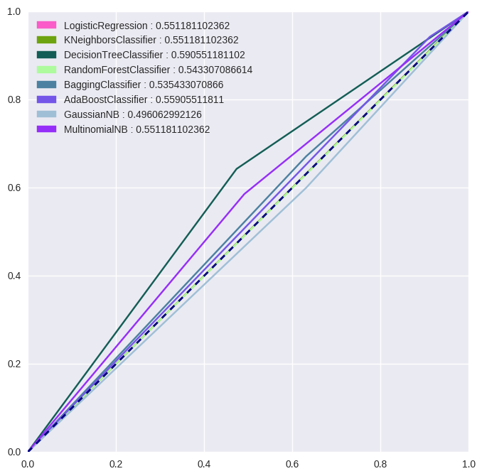
Model Performance (USING POS TAGS)
ngram = 2, with tf-idf representation
Model | Accuracy | F1 | Precision | Recall
LogisticRegression | 0.551181 | 0.710660 | 0.551181 | 1.000000
KNeighborsClassifier | 0.551181 | 0.710660 | 0.551181 | 1.000000
DecisionTree | 0.590551 | 0.633803 | 0.625000 | 0.642857
RandomForest | 0.543307 | 0.691489 | 0.550847 | 0.928571
BaggingClassifier | 0.535433 | 0.614379 | 0.566265 | 0.671429
AdaBoostClassifier | 0.559055 | 0.702128 | 0.559322 | 0.942857
GaussianNB | 0.496063 | 0.567568 | 0.538462 | 0.600000
MultinomialNB | 0.551181 | 0.589928 | 0.594203 | 0.585714
Decision Tree has the highest accuracy (0.590551)
DecisionTree with tfidf and ngram = 1 using POS tags performs best

Slide 20
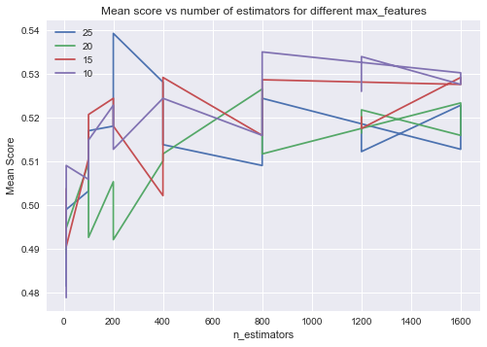
Grid Search
It clearly necessitated the need for tuning the hyper parameters( C, kernel, gamma, max_features, max_depth, n_estimators, etc) on the models we have just seen
GridSearchCV helped optimize and find the best parameters for the classification models.
With the help of Grid Search, we have come to the standing of best accuracy of 63.5 % for random forest

Slide 21

Sentiment Analysis

Slide 22
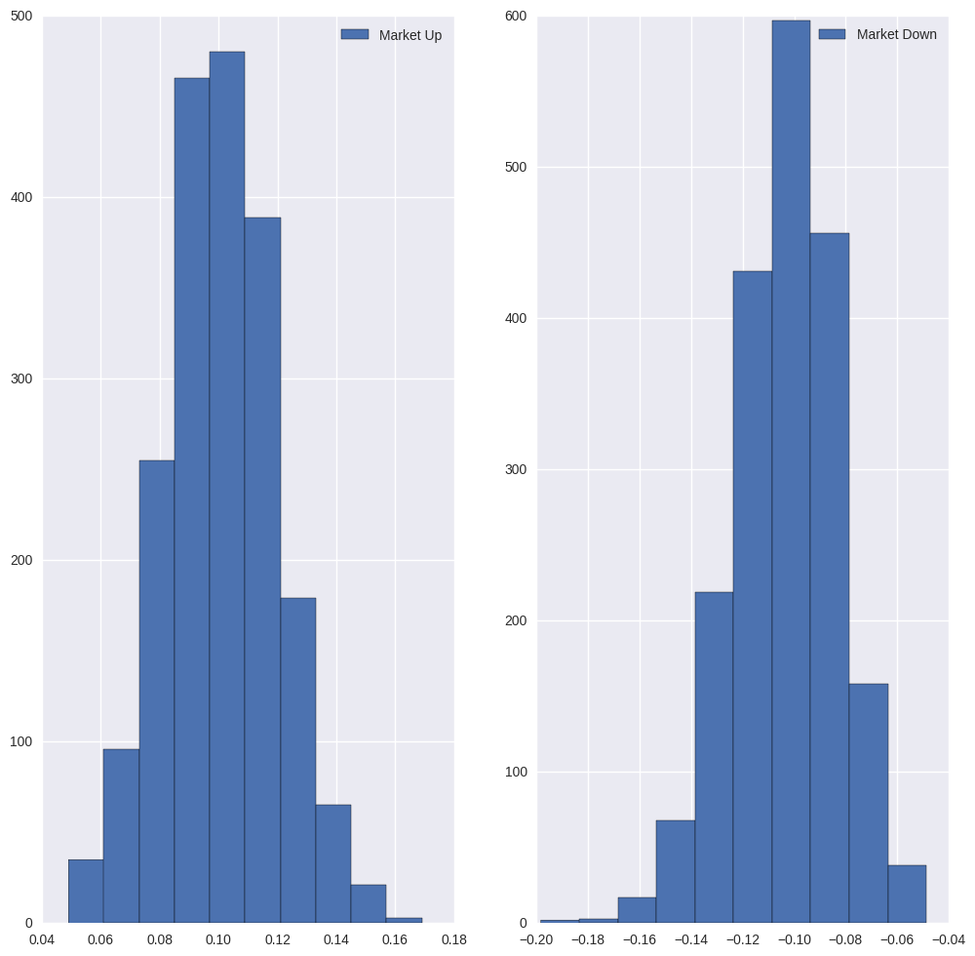
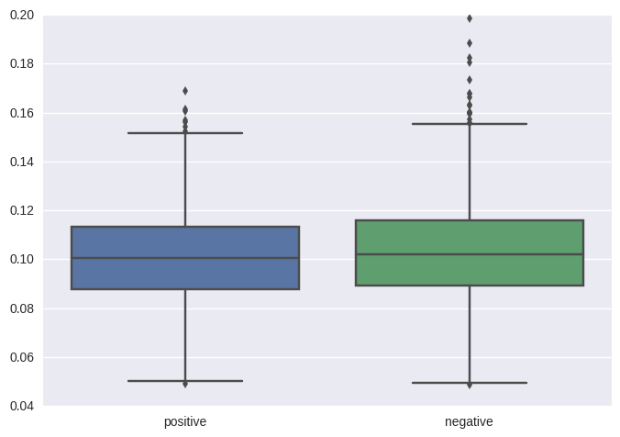
Exploratory on Sentiment Analysis
Sentiment Histogram
Sentiment Boxplot
More variation for negative sentiment
Similar distribution of sentiment score for both labels

Slide 23
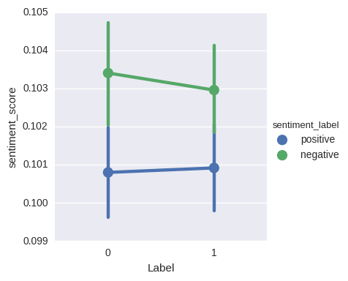
Sentiment SCORE vs MARKET MOVEMENT
Average negative sentiment score is decreasing when the market is moving up (label = 1)
Average positive sentiment score is increasing when the market is moving up (label = 1)

Slide 24
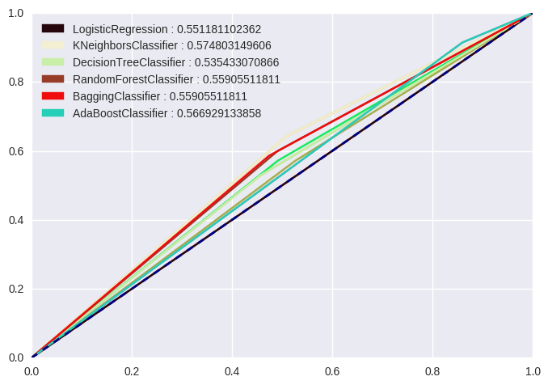
Model Performance
Using only net sentiment score:
Model | Accuracy | F1 | Precision | Recall
LogisticRegression | 0.551181 | 0.710660 | 0.551181 | 1.000000
KNeighbors | 0.574803 | 0.625000 | 0.608108 | 0.642857
DecisionTree | 0.535433 | 0.556391 | 0.587302 | 0.528571
RandomForest | 0.559055 | 0.600000 | 0.600000 | 0.600000
Bagging | 0.559055 | 0.594203 | 0.602941 | 0.585714
AdaBoost | 0.566929 | 0.699454 | 0.566372 | 0.914286
Kneighbors Classifier has the highest accuracy (0.5748)

Slide 25
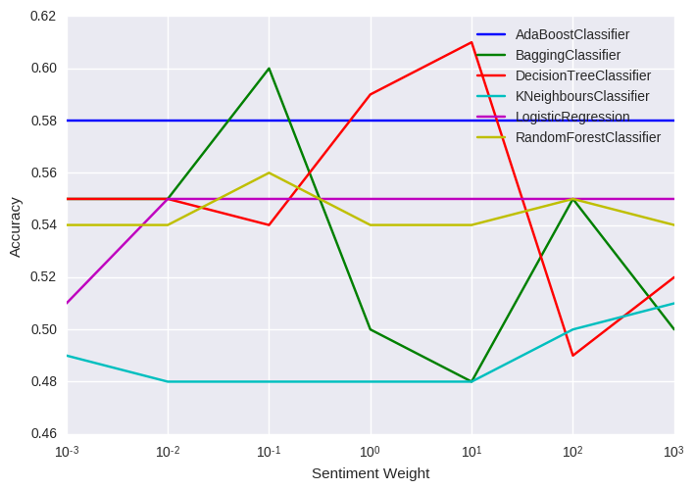
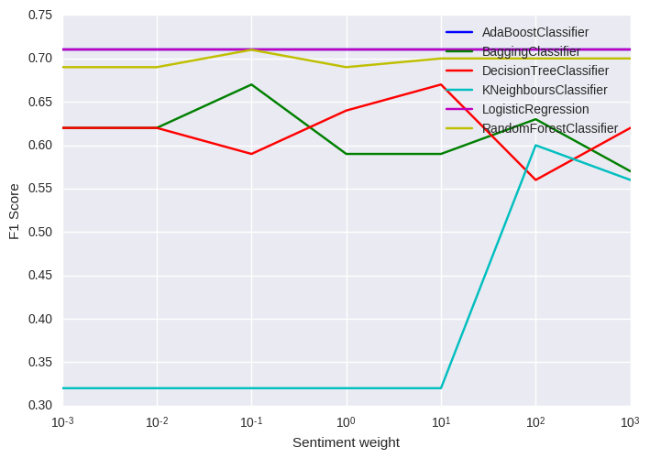
Plot of accuracy and F1 score with sentiment weight, Ngram = 2
Most of the models’ accuracy and F1 score vary with different sentiment weight
DecisionTree is showing most variance while AdaBoost and Logistic are least sensitive
Sentiment Score weight at W = 10 is most optimal

Slide 26
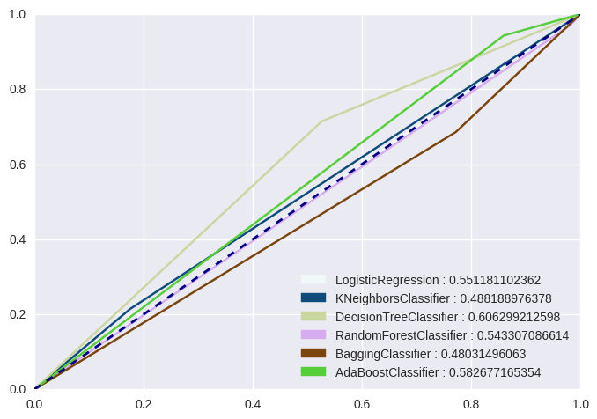
ROC curve for Sentiment Weight, W = 10
DecisionTree classifier with best accuracy = 60 and sentiment weight( W ) = 10
AdaBoost Classifier performs second best but no shows no variance with sentiment weight.

Slide 27

Challenges and Key Takeaways

Slide 28
Challenges
The news data failed to provide timestamp for the given days, and hence was difficult to relate whether the news was during the market hours or post market hours.
Topic modelling failed to provide any prominent topics for the entire corpus(8years)
Because of limited lexicon, it was difficult to accurately perform Semantic and Sentiment analysis.

Slide 29
Key Takeaways
Grid Search helped us in narrowing the best model and the best parameters to go along with it.
Considering the news source (Reddit) which is quite a mixed bag of formal and informal news, the results aren’t as weak as they might sound.
If we were to add/ focus more on the financial news, the results could have been even more influencing.

Slide 30

Conclusion

Slide 31
CONCLUSION
Using Noun phrases BOW tfidf representation shows improvement over all words BOW tfidf representation at accuracy of 60% with DecisionTree classifier.
In most of the representations ngram = 2 shows superior performance over ngram = 1 implying phrases rather than words have more predictive power.
Including sentiment score to the BOW shows distinct improvement in the accuracy and overall predictive power of the model
DecisionTree with BOW tfidf and ngram =2 with weighted sentiment at weight, W = 10 shows the best performance metrics at accuracy of 60.6%
Amongst the ensemble models, Random Forest and AdaBoost show good performance with assistance from Grid Search(63%)

Slide 32


